Slide 1
Maximum domination of k-vertex subset in trees
Author: Yan-Tong Lin
Advisor: Prof. Chiuyuan Chen

Slide 2
Overview
Task Description
Related Works
Proposed Algorithm
Vanilla DP
SMAWK’s Optimization
Demos
Notes:
Overview
Task Description
Related Works
Proposed Algorithm
Vanilla DP
SMAWK’s Optimization
Demos

Slide 3
The Task

Slide 4
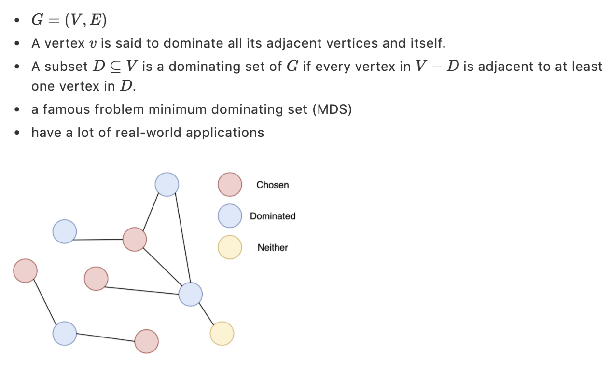
Task description (Domination and MDS)
Notes:
Task description (Domination and MDS)
G=(V,E)G=(V,E)
A vertex vv is said to dominate all its adjacent vertices and itself.
A subset D⊆VD⊆V is a dominating set of GG if every vertex in V−DV−D is adjacent to at least one vertex in DD.
a famous froblem minimum dominating set (MDS)
have a lot of real-world applications

Slide 5
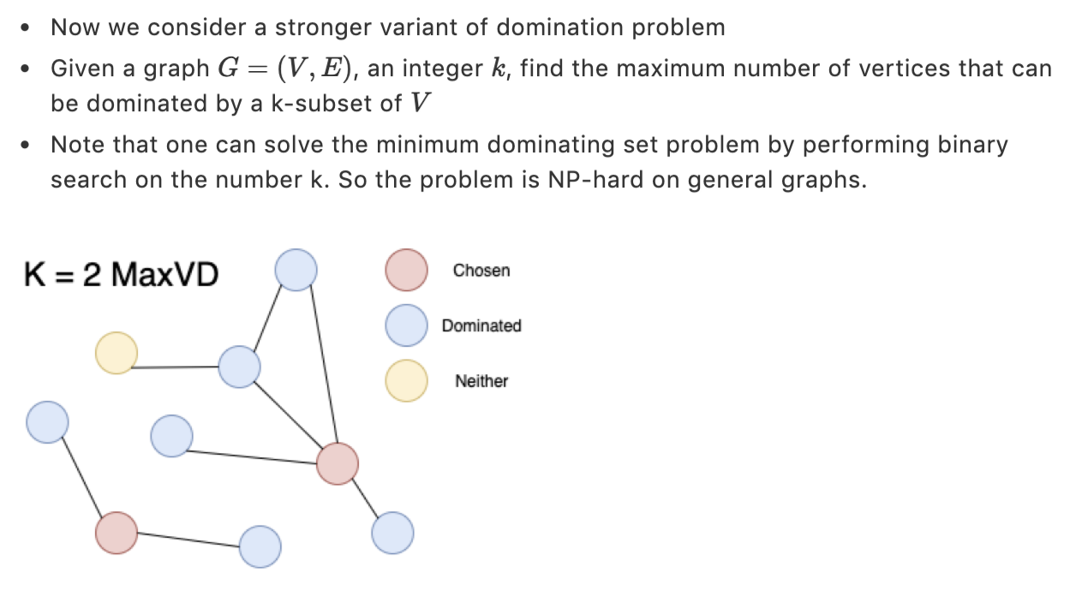
k-Maximum vertex domination(k-MaxVD)
Notes:
k-Maximum vertex domination(k-MaxVD)
Now we consider a stronger variant of domination problem
Given a graph G=(V,E)G=(V,E), an integer kk, find the maximum number of vertices that can be dominated by a k-subset of VV
Note that one can solve the minimum dominating set problem by performing binary search on the number k. So the problem is NP-hard on general graphs.
Note: best since |MDS| is 3

Slide 6
Related Works

Slide 7
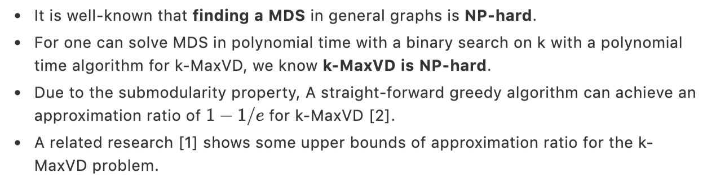
Related Works
Notes:
Related Work
It is well-known that finding a MDS in general graphs is NP-hard.
For one can solve MDS in polynomial time with a binary search on k with a polynomial time algorithm for k-MaxVD, we know k-MaxVD is NP-hard.
Due to the submodularity property, A straight-forward greedy algorithm can achieve an approximation ratio of 1−1/e1−1/e for k-MaxVD [2].
A related research [1] shows some upper bounds of approximation ratio for the k-MaxVD problem.

Slide 8
Related Work(cont.)
The problem in general graphs has shown its NP-hardness and a certain degree of inapproximability.
However, there is a linear-time algorithm for MDS on cactus graphs [3].
So we believe the existence of a polynomial time algorithm for k-MaxVD problem on trees.
Notes:
Related Work(cont.)
The problem in general graphs has shown its NP-hardness and a certain degree of inapproximability.
However, there is a linear time algorithm for MDS on cactus graphs[3].
So we believe the existence of a polynomial time algorithm for k-MaxVD problem on trees.

Slide 9
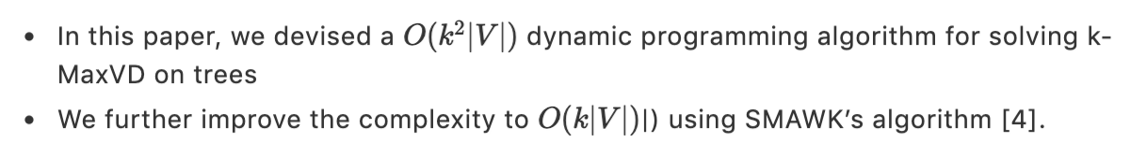
The main contribution
Notes:
The main contribution
In this paper, we devised a O(k2|V|)O(k2|V|) dynamic programming algorithm for solving k-MaxVD on trees
We further improve the complexity to O(k|V|)O(k|V|)|) using SMAWK’s algorithm [4].

Slide 10
Proposed Algorithm

Slide 11
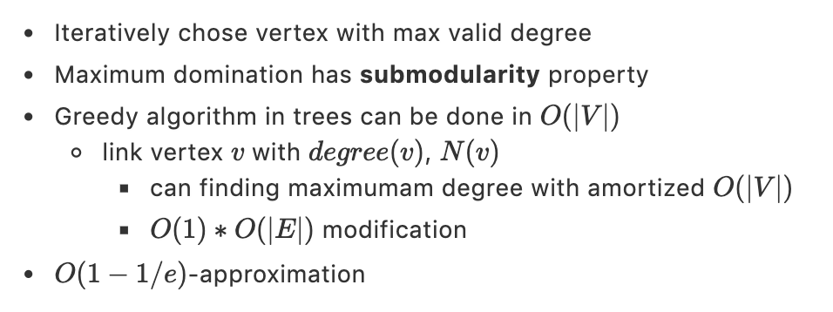
The Greedy Algorithm
Notes:
The Greedy Algorithm
Iteratively chose vertex with max valid degree
Maximum domination has submodularity property
Greedy algorithm in trees can be done in O(|V|)O(|V|)
link vertex vv with degree(v)degree(v), N(v)N(v)
can finding maximumam degree with amortized O(|V|)O(|V|)
O(1)∗O(|E|)O(1)∗O(|E|) modification
O(1−1/e)O(1−1/e)-approximation

Slide 12
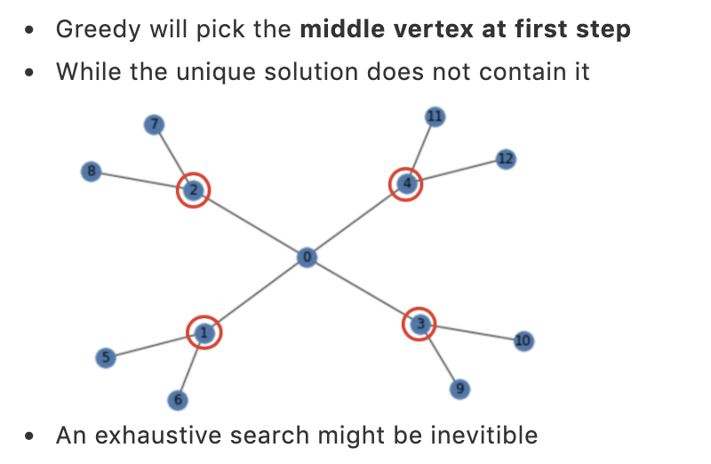
Greedy can be wrong
Notes:
Note: A greedy algorithm that recursively choose the vertex with biggest valid degree fails when there are shared edges that connect the first k max degree vertices. An exhaustive search might be required to solve the issue.

Slide 13
The Vanilla DP solution

Slide 14
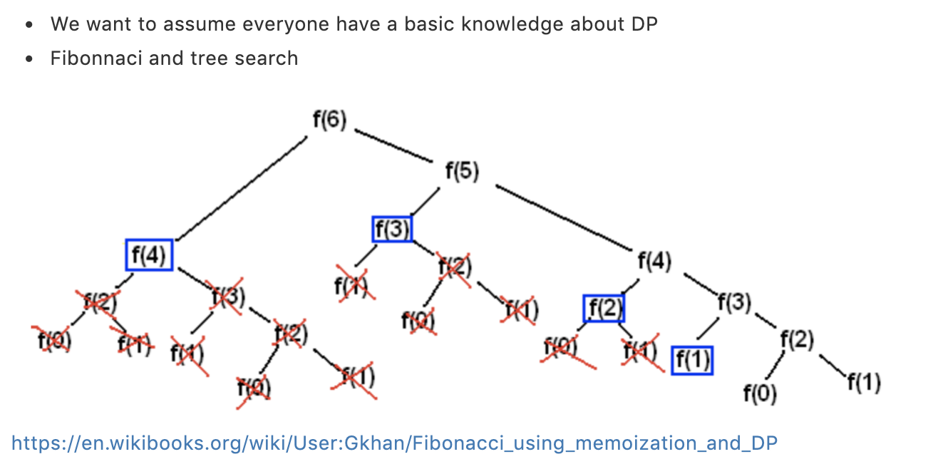
Dynamic Programming 101
Notes:
We want to assume everyone have a basic knowledge about DP
Fibonnaci and tree search
https://en.wikibooks.org/wiki/User:Gkhan/Fibonacci_using_memoization_and_DP

Slide 15
Motivation of using dynamic programming
As doing exhaustive search, one may noticed that the optimal solution of a subtree rooted at u (opt(u, k)) can be determined by those of u’s children.
This motivates us to think of the technique of memorization to avoid recalculations of children’s result.
Notes:
As doing exhaustive search, one may noticed that the optimal solution of a subtree rooted at u (opt(u,k) can be determined by those of u’s children.
This motivates us to think of the technique of memorization to avoid recalculations of children’s result.

Slide 16
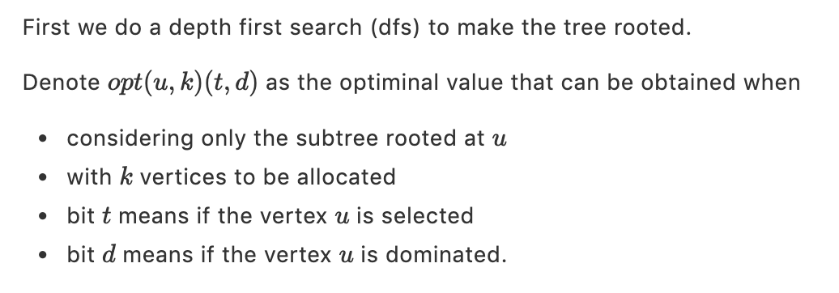
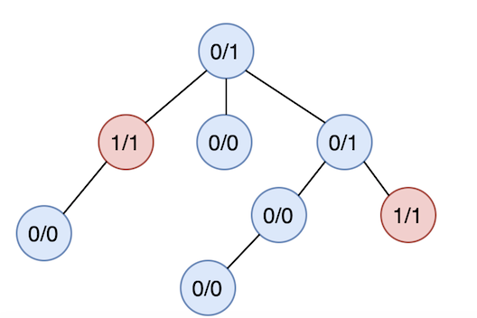
Transition (Part A)

Slide 17
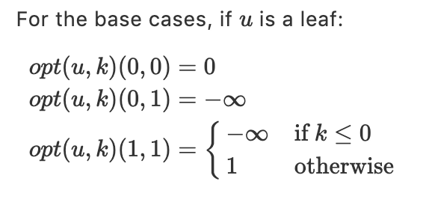
Transition (part B)

Slide 18
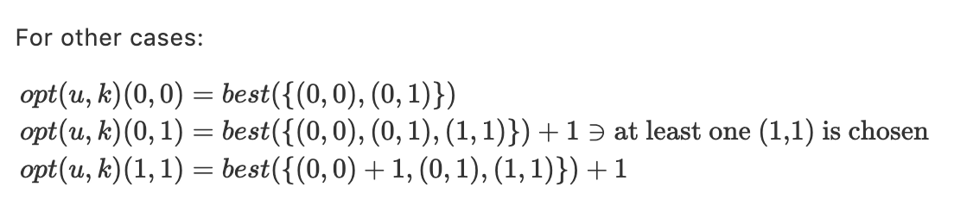
Transition (Part C)
Notes:
Note: The best(S)best(S) is the optimal value that we can get by distributing the k (or k-1, if the root uu uses one quota) available vertices to subtrees of uu, with the cases of the subtrees’ roots are in SS. This can be done by an analog to the well-known knapsack algorithm.

Slide 19
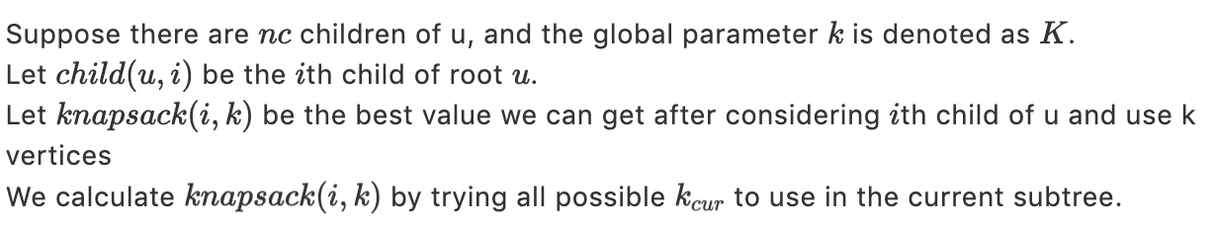
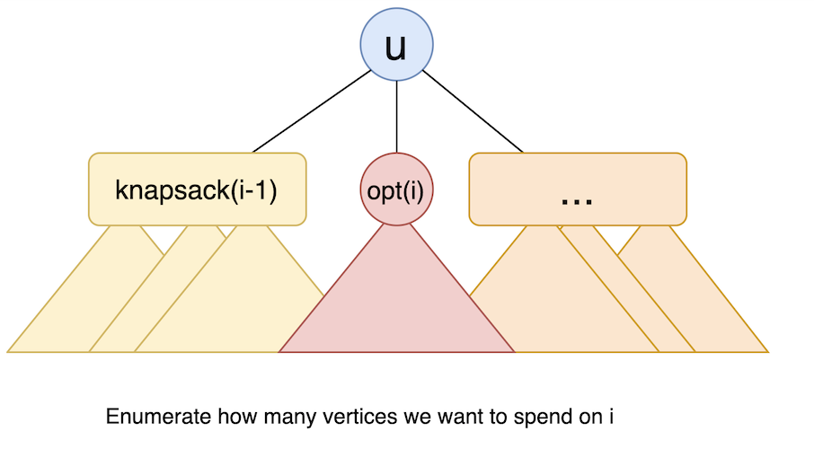
Transition (Part D)

Slide 20
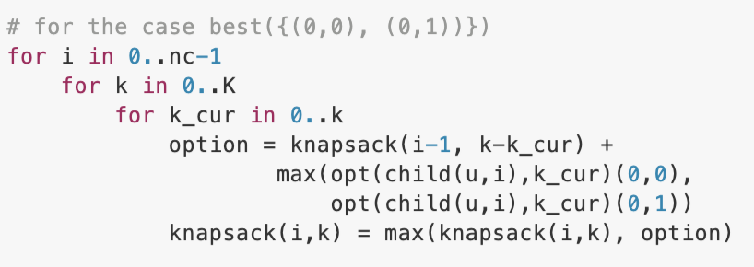
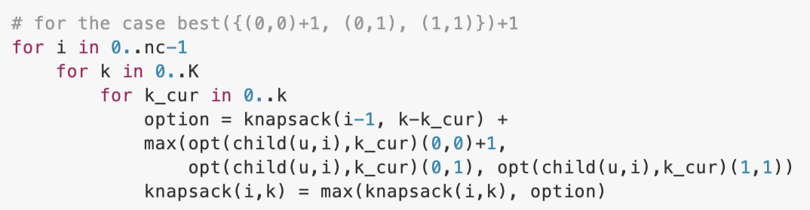

Slide 21
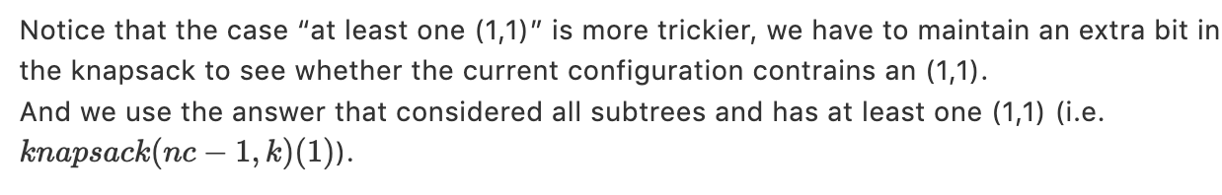
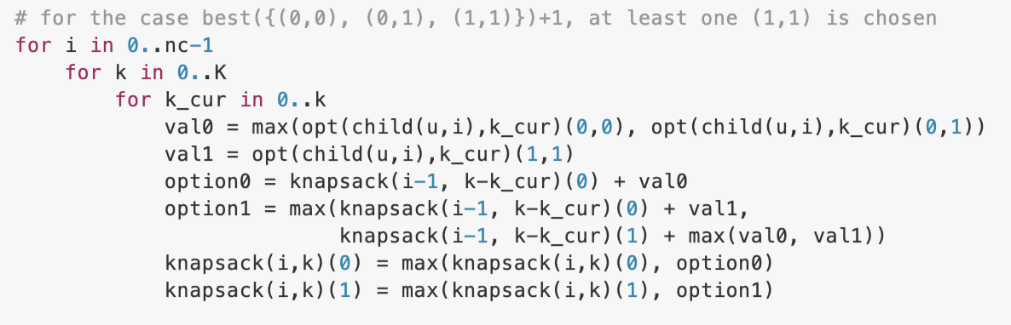
Transition (Part D) (cont.)

Slide 22
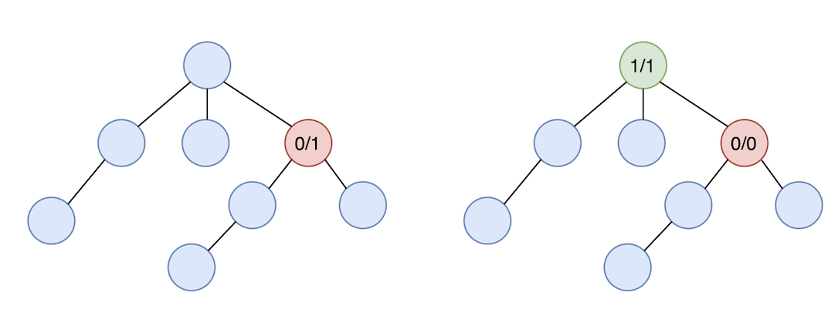
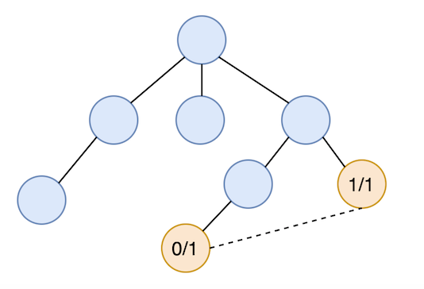
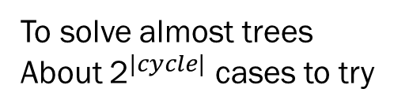
Utility of the proposed algorithm by setting −∞ to undesired states
To make the red dominated but not chosen
(This scenario is quite common in real world)
2 cases to try
To solve almost trees
About ${\text{2}}^{|cycle|}$ cases to try

Slide 23
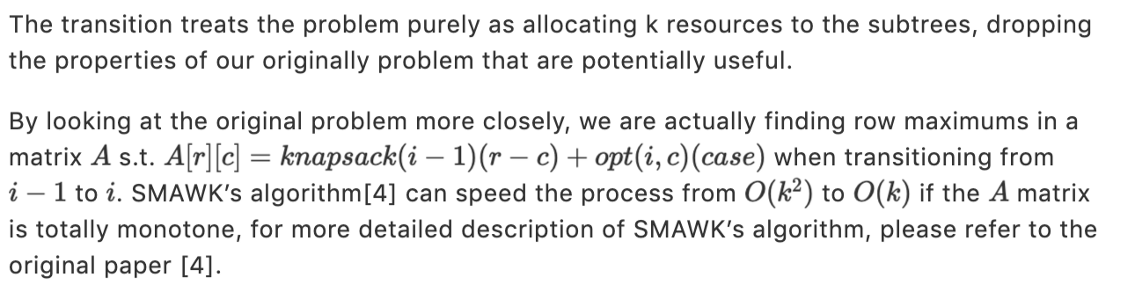
Optimization with monge property

Slide 24
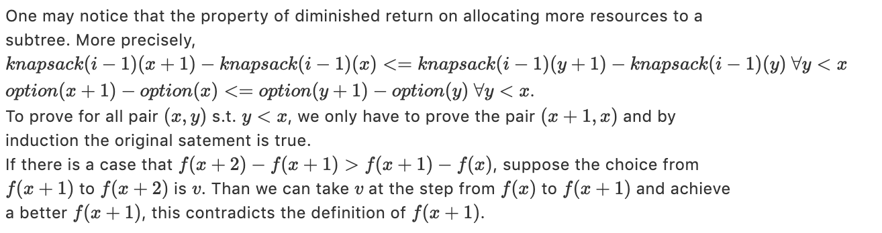
Optimization with monge property (cont.)

Slide 25
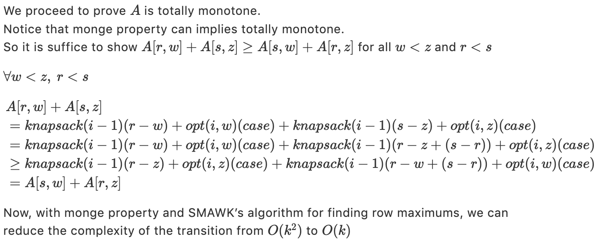
Optimization with monge property (cont.)

Slide 26
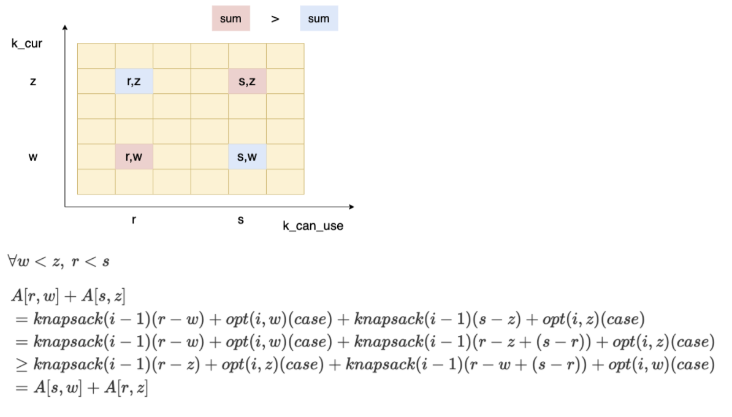
Optimization with monge property (cont.)

Slide 27
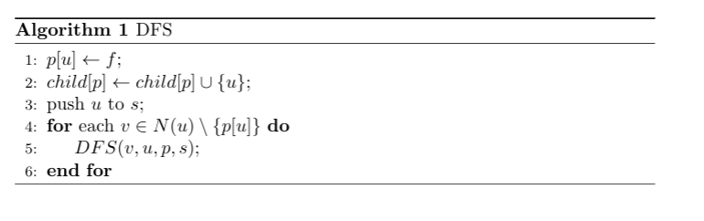
Pseudo Code

Slide 28
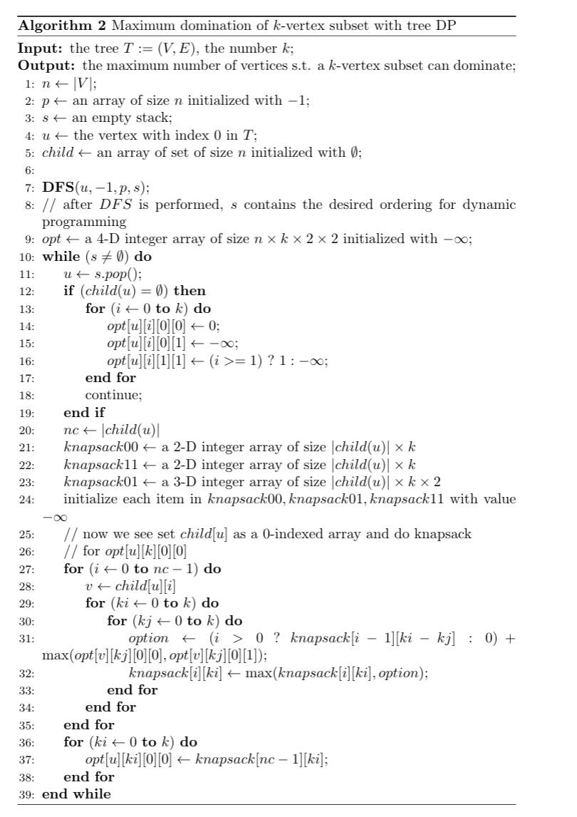
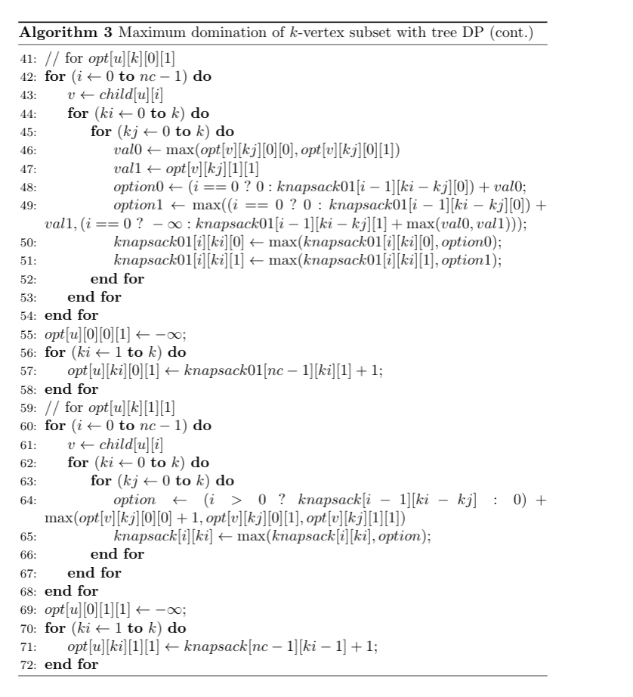
Pseudo Code (cont.)

Slide 29
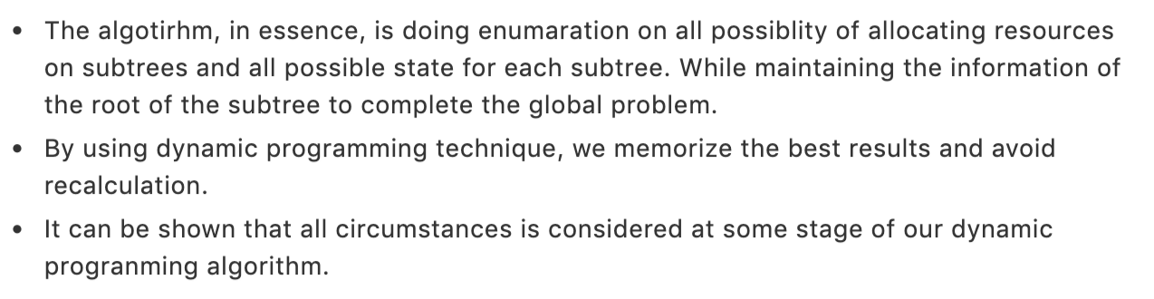
Correctness of Algorithm

Slide 30
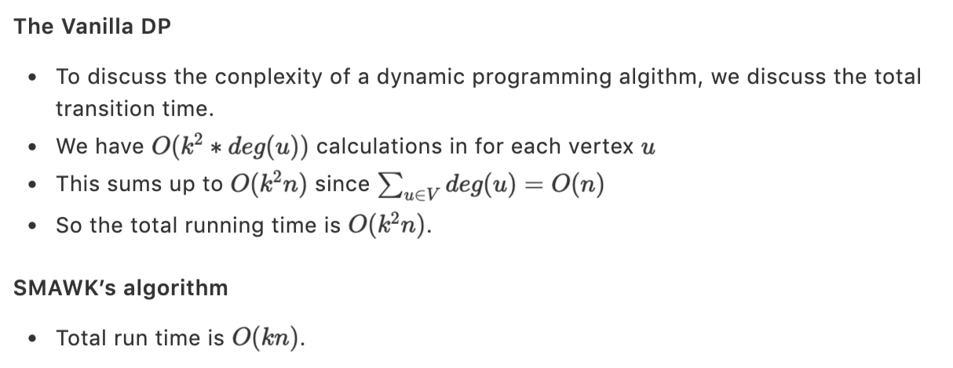
Time Complexity Analysis

Slide 31
Experimental Results
Code realization
Examples
Time Complexity Testing

Slide 32
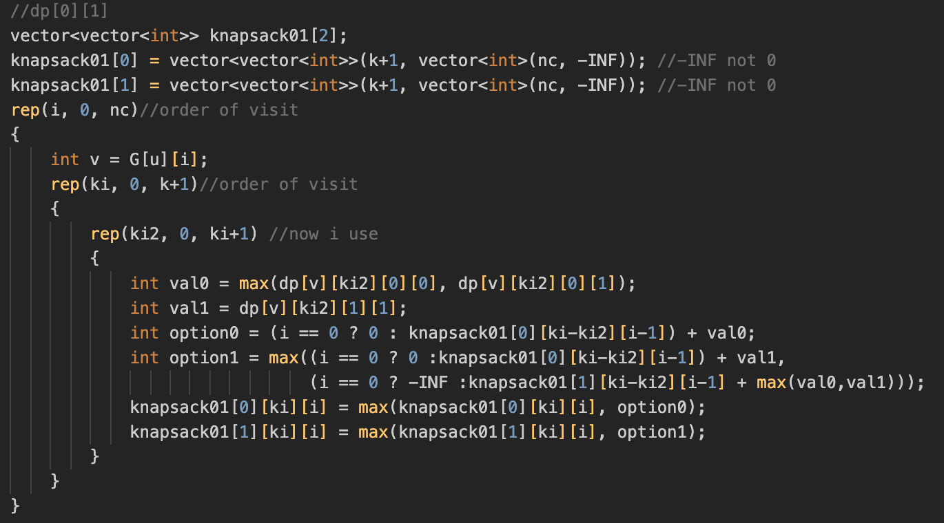
Partial C++ Code

Slide 33
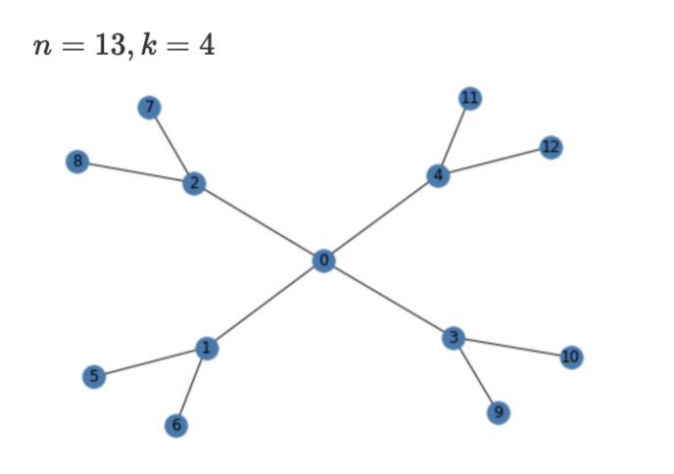
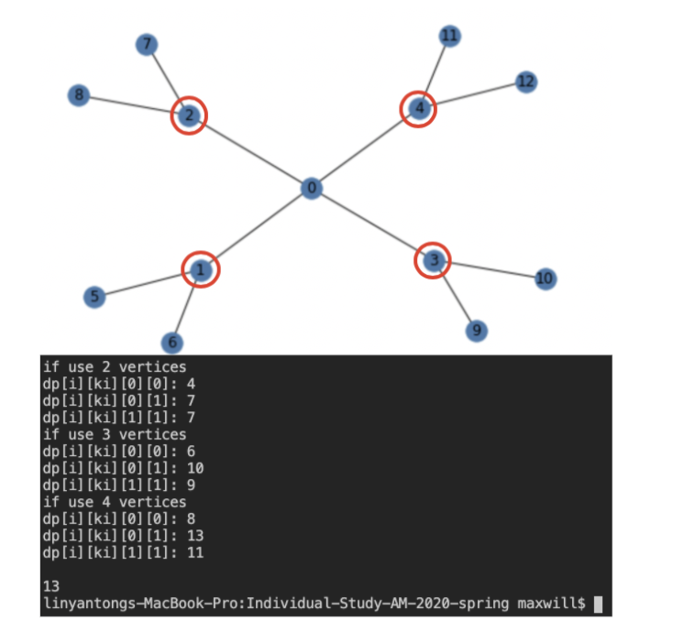
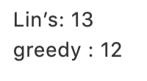
Example 1 – Handcraft testcase

Slide 34
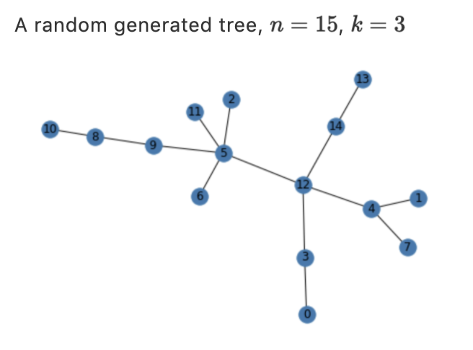
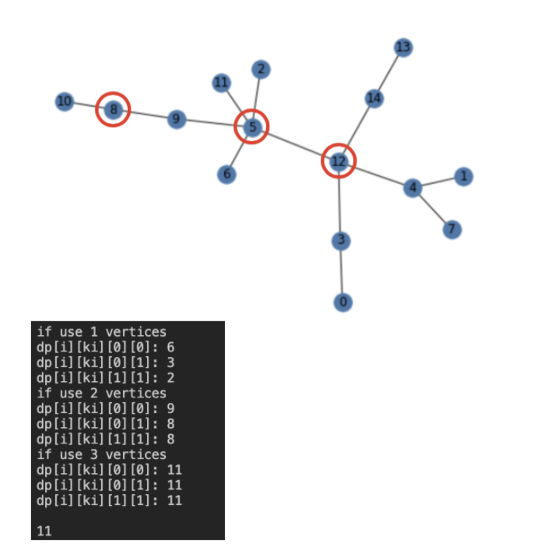
Example 2 – Random Small

Slide 35
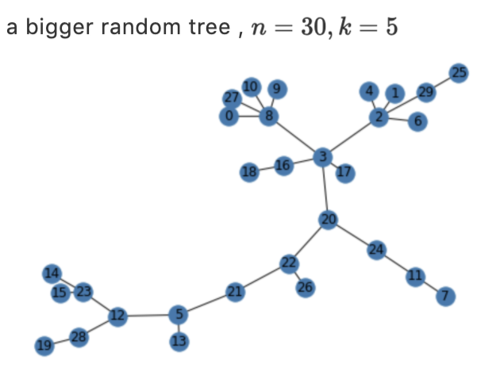
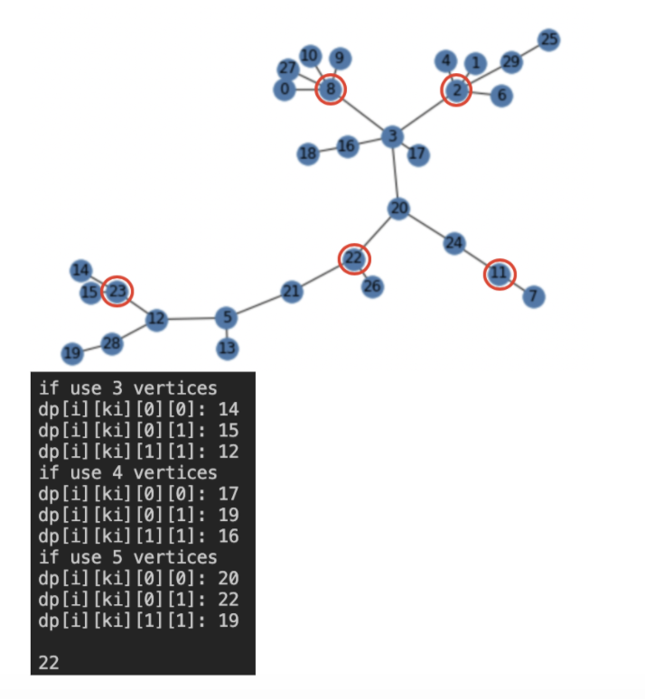
Example 3 – Random Large
A truly large (ex: 10000+ nodes) test case is not easy to visualize, so we use a smaller one to demo
But we have verified that our solution is correct on a larger datum

Slide 36
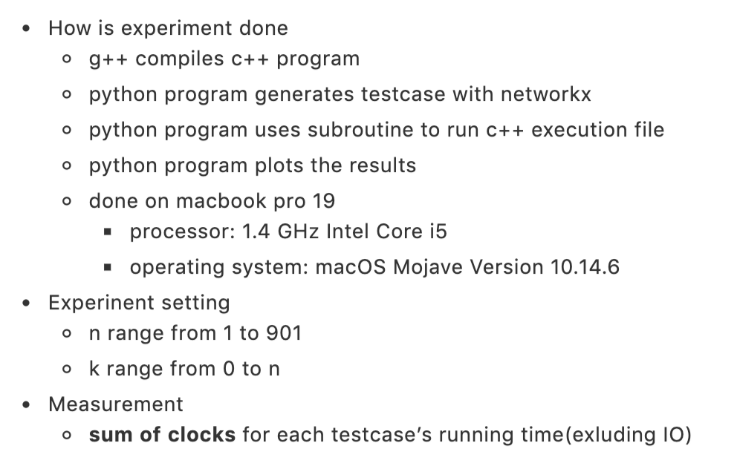
Time Complexity Testing

Slide 37
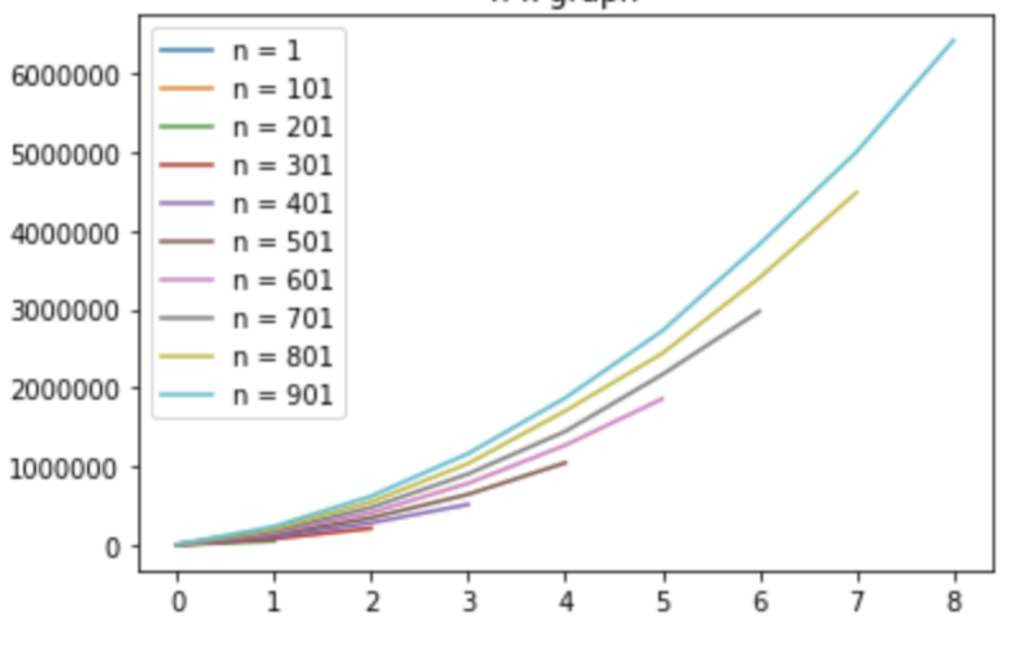
K-T graph

Slide 38
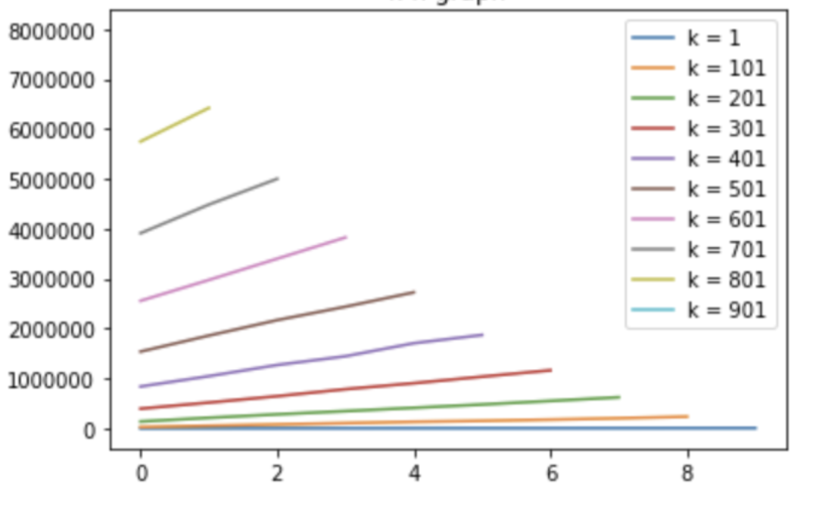
N-T graph

Slide 39
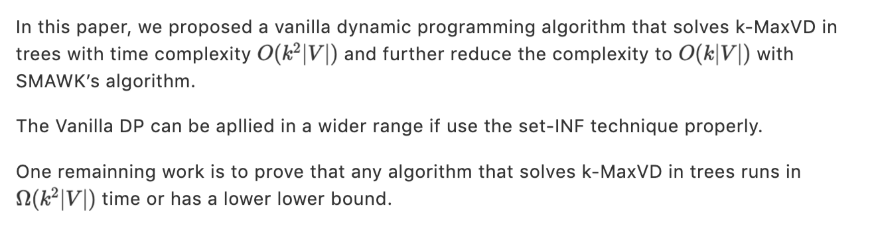
Concluding Remark

Slide 40
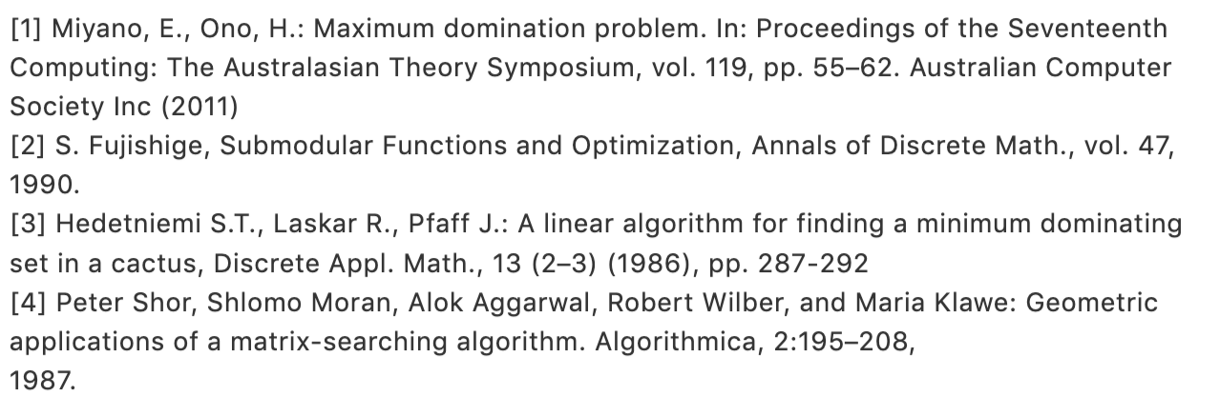
Reference

Slide 41
Acknowledgements
I would like to thank Dr. Chiuyuan Chen, my instructor of individual study, for giving me a lot of advices and help me come up with interesting ideas.
I would also like to thank Dr. Meng-Tsung Tsai, my teacher of Advanced Algorithms, for encouraging me to utilize the knowledge in the class.
And thank you for listening!

